Slide 1
Superstore Sales Analysis
Unlocking Insights: Superstore Sales Data Dive

Slide 2
Appendix
Introduction
Data Preprocessing
Dashboard Preparation
Sales Forecasting – Dashboard
Tools Used
Challenges Faced
Conclusion - Actionable Insights and Recommendations

Slide 3
Introduction
Objective
To contribute to the success of a business by utilizing data analysis techniques, specifically focusing on time series analysis, to provide valuable insights and accurate sales forecasting.
DESCRIPTION
The objective can be broken down into the following detailed components:
Dashboard Creation: Identify the KPIs, design an intuitive and visually appealing dashboard, add interactive visualizations and filtering capabilities to allow users to explore the data at various levels of granularity
Data Analysis: Provide valuable insights to business entities regarding the effectiveness of their sales strategies through visualisations and charts
Sales Forecasting: Leverage historic data and apply time series analysis to generate sales forecast for next 15 days
Actionable Insights and Recommendations: end goal is to provide insights and actionable information that can drive strategic decisions and support the supermarkets goals for growth, efficiency and satisfaction

Slide 4
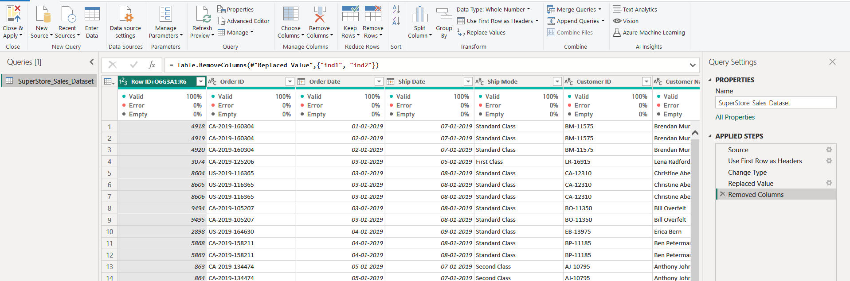
Data Preprocessing
Imported Data in Power BI Desktop
Performed required Data Transformations for further data analysis such as removing unnecessary columns and empty rows, setting first row as header, replacing values in columns, etc.

Slide 5
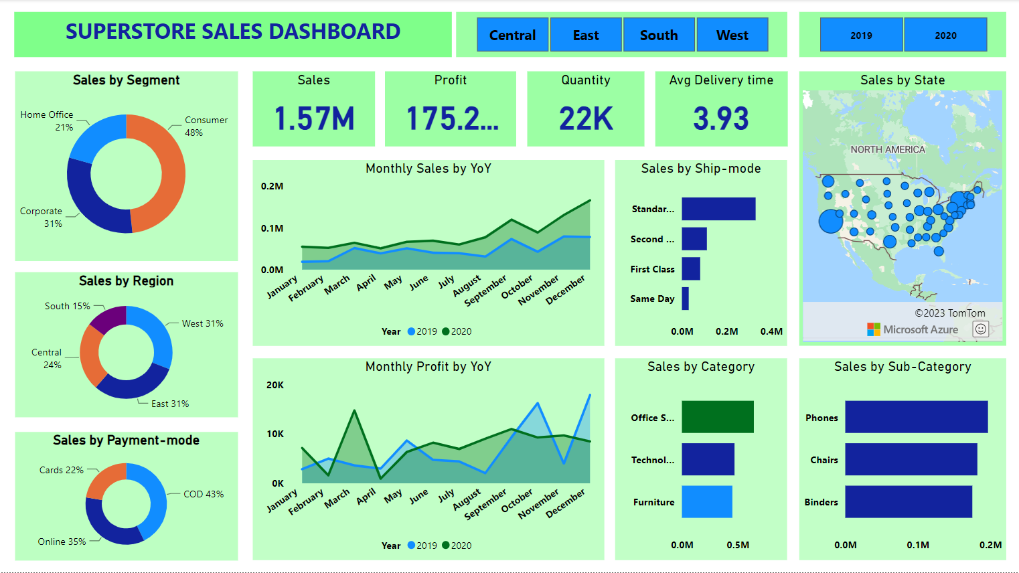

Slide 6
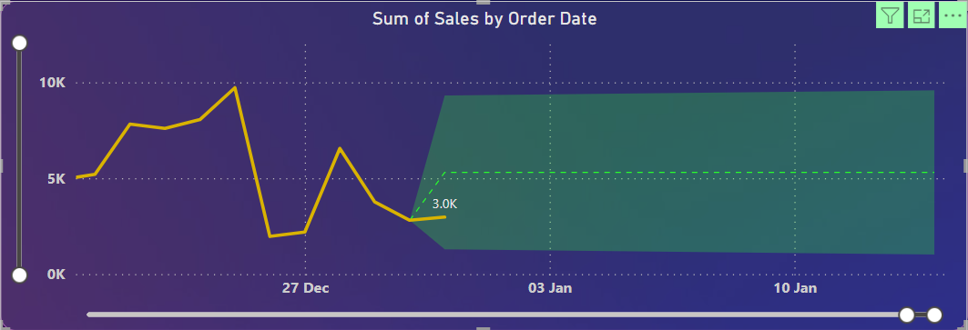
Sales Forecasting
Sales forecasting is the process of estimating future sales or revenue for a business or organization. It is a critical aspect of business planning and decision-making, as it helps businesses anticipate demand, allocate resources, set targets, and make informed strategic decisions.
Created a forecasting chart based on daily sales in year 2019 and 2020 and predicted sales for 15 days in January 2021.

Slide 7
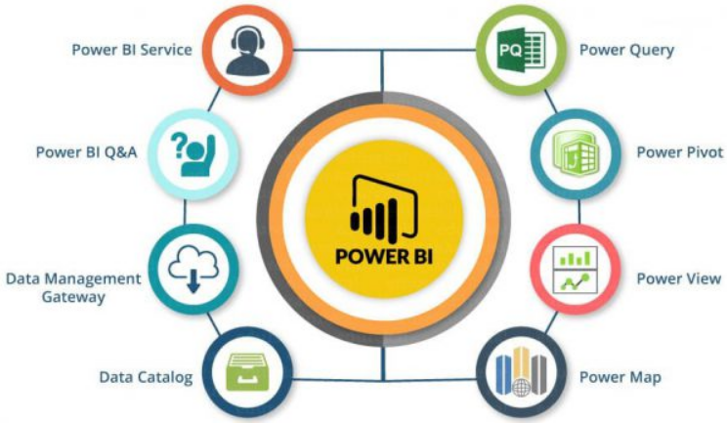
Tools Used

Slide 8
Challenges Faced and Measures Taken
Challenge 1: Chart Design
- Clarity in representing sales data.
- Proper labeling, scaling, and chart type.
- Consistent colors, annotations, and interactivity.
Challenge 2: DAX Query
- Understanding DAX syntax.
- Accurate column creation.
- Handling complexity if needed.
Challenge 3: 15-Day Sales Forecast
- Selecting forecasting methodology.
- Accounting for seasonality and external factors.
- Ensuring data accuracy and model adaptability.

Slide 9
Conclusion
Actionable Insights and Recommendations –

